Slide 1




AD_HOC INSIGHTS​
Consumer Goods of AtliQ Hardware

Slide 2




AGENDA
About the Data
Objective
Company Overview
Ad_Hoc Request Insights​

Slide 3
COMPANY OVERVIEW
Who We Are:​
AtliQ Hardware is one of India's leading computer hardware producers.​
Has strong international presence across multiple regions​.
Comprehensive product portfolio spanning PC components, networking, andstorage solutions​.
Our Reach:​
Regions: APAC, Europe, North America, Latin America​
Distribution Channels: Retailers, Direct Sales, Distributors​
Platforms: Brick & Mortar and E-Commerce​
Current Challenge:​
Limited data-driven insights for strategic decision making​.
Need for enhanced analytics capabilities to maintain competitive edge​.
Expanding data analytics team to support rapid growth​.

Slide 4
OBJECTIVE
To empower executive management with clear, actionable insights derived through SQL-based analysis for ad hoc business questions.​
Deliver quick insights to inform strategic decisions​.
Demonstrate technical SQL proficiency and business understanding.
Provide visually engaging and data-rich outputs for management.

Slide 5
ABOUT THE DATA
The insights are derived from the Atliq Hardware Database (gdb023) whichincludes:​
6 Key Tables:​
dim_customer – Customer profiles, market, region, and channel info​
dim_product – Product hierarchy including segment, division, andvariants​
fact_sales_monthly – Monthly sales and quantity data​
fact_manufacturing_cost – Yearly product manufacturing costs​
fact_gross_price – Fiscal year-wise product prices​
fact_pre_invoice_deductions – Discount percentages applied pre-invoice​
Time Frame: Data covers fiscal years 2020 and 2021.​
Fiscal Year: Starts from September, ends at August cycle.​

Slide 6
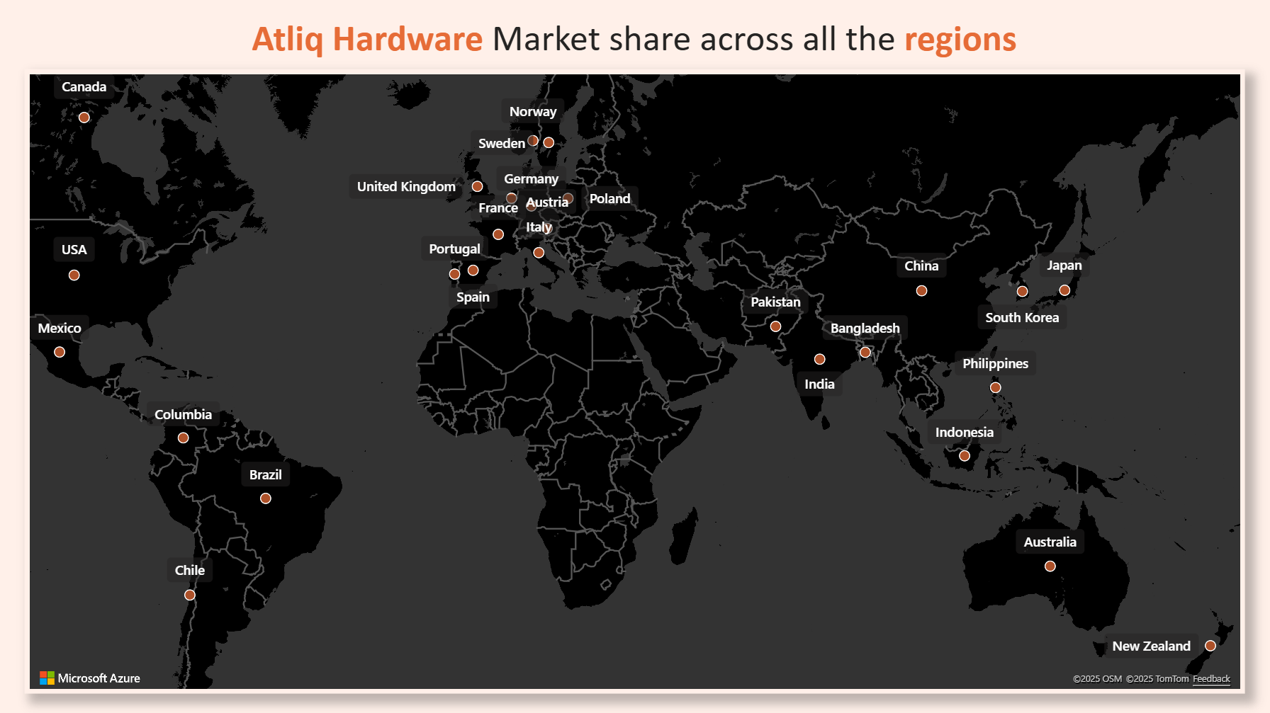

Slide 7
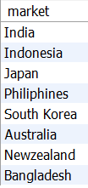
Request 1: Provide the list of markets in which customer "Atliq Exclusive" operates its business in the APAC region.
Result
SELECT
DISTINCT market
FROM dim_customer
WHERE customer = "Atliq Exclusive"
AND region = "APAC";

Slide 8
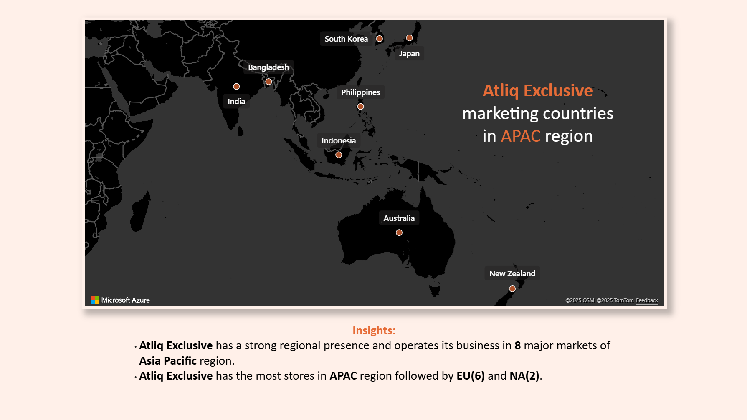

Slide 9
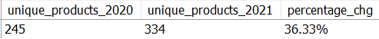
Request 2: What is the percentage of unique product increase in 2021 vs. 2020?
WITH
unique_products AS
(SELECT
COUNT(DISTINCT
IF(fiscal_year = 2020, product_code, NULL)) AS unique_products_2020,
COUNT(DISTINCT
IF(fiscal_year = 2021, product_code, NULL)) AS unique_products_2021
FROM fact_sales_monthly)
SELECT
*,
CONCAT(ROUND(((unique_products_2021-unique_products_2020)/unique_products_2020)*100, 2), "%")
AS percentage_chg
FROM unique_products;
Result

Slide 10
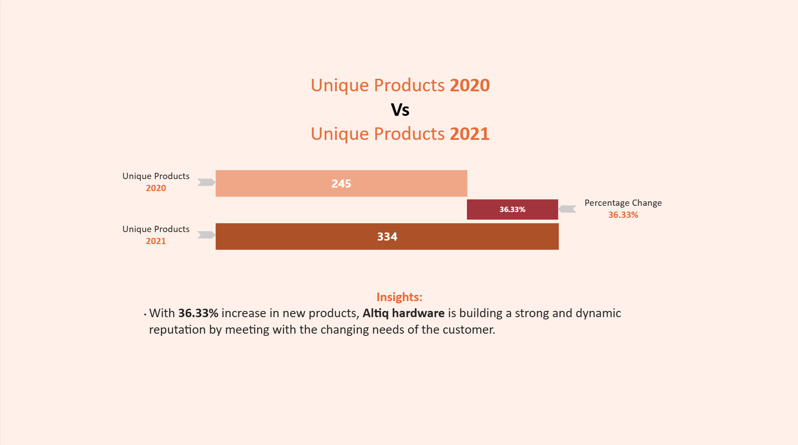

Slide 11
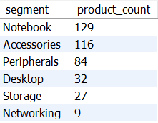
Request 3: Provide a report with all the unique product counts for each segment and sort them in descending order of product counts.
SELECT
segment,
COUNT(distinct product_code) AS product_count
FROM dim_product
GROUP BY segment
ORDER BY product_count DESC;
Result

Slide 12
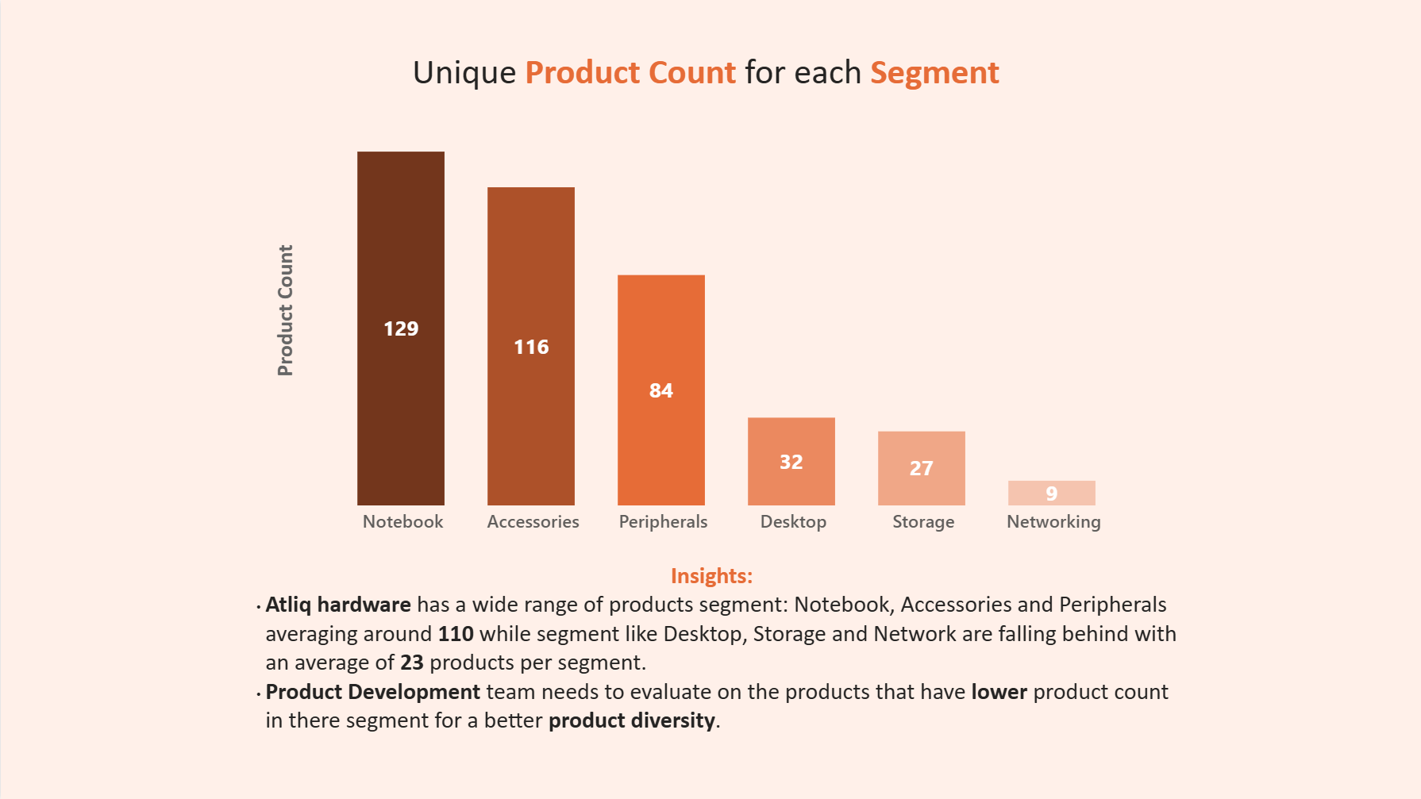

Slide 13
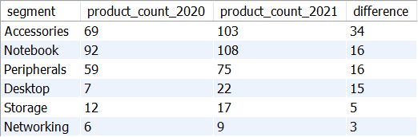
Request 4: Which segment had the most increase in unique products in 2021 vs 2020?
WITH
products_by_segment AS
(SELECT
p.segment AS segment,
COUNT(DISTINCT
IF(s.fiscal_year = 2020, s.product_code, NULL)) AS product_count_2020,
COUNT(DISTINCT
IF(s.fiscal_year = 2021, s.product_code, NULL)) AS product_count_2021
FROM dim_product p
JOIN fact_sales_monthly s
ON p.product_code = s.product_code
GROUP BY segment)
SELECT
*,
product_count_2021-product_count_2020 AS difference
FROM products_by_segment
ORDER BY difference DESC;
Result

Slide 14
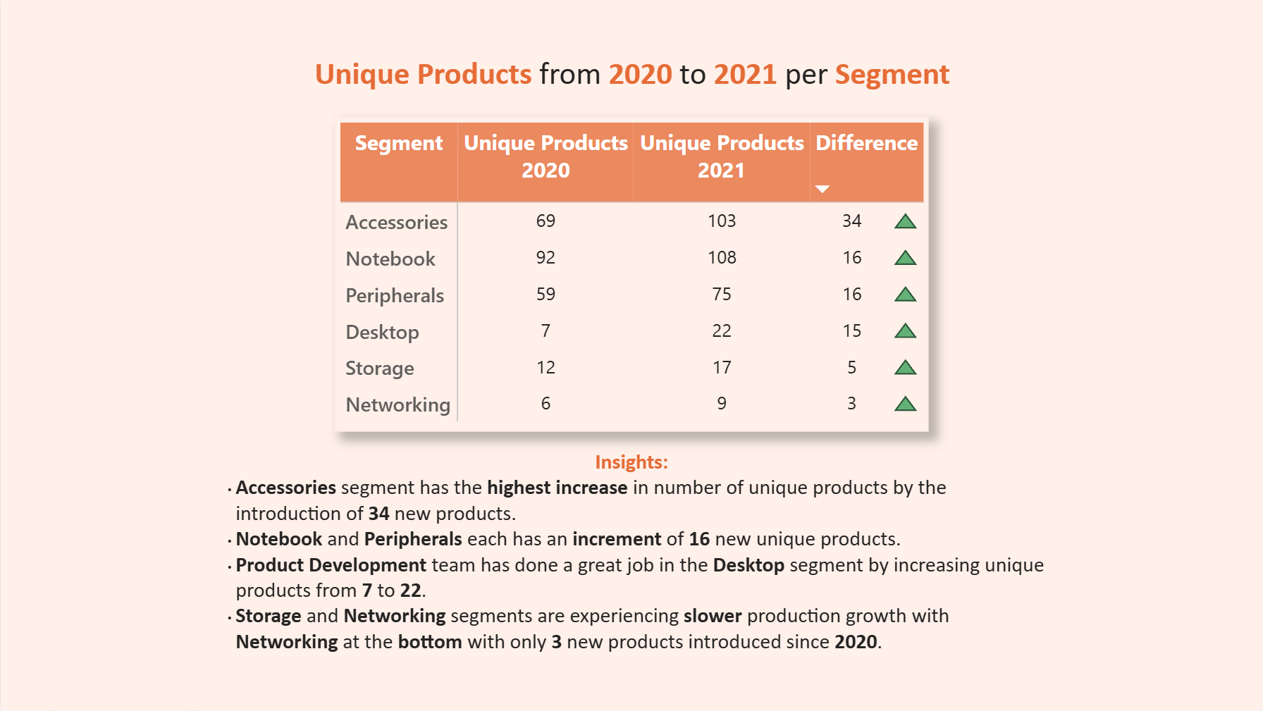

Slide 15
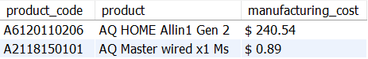
Request 5: Get the products that have the highest and lowest manufacturing costs.
SELECT
p.product_code AS product_code,
p.product AS product,
CONCAT("$ ", ROUND(m.manufacturing_cost, 2)) AS manufacturing_cost
FROM dim_product p
JOIN fact_manufacturing_cost m
ON p.product_code = m.product_code
WHERE manufacturing_cost IN(
(SELECT
MAX(manufacturing_cost)
FROM fact_manufacturing_cost),
(SELECT
MIN(manufacturing_cost)
FROM fact_manufacturing_cost))
ORDER BY manufacturing_cost DESC;
Result

Slide 16
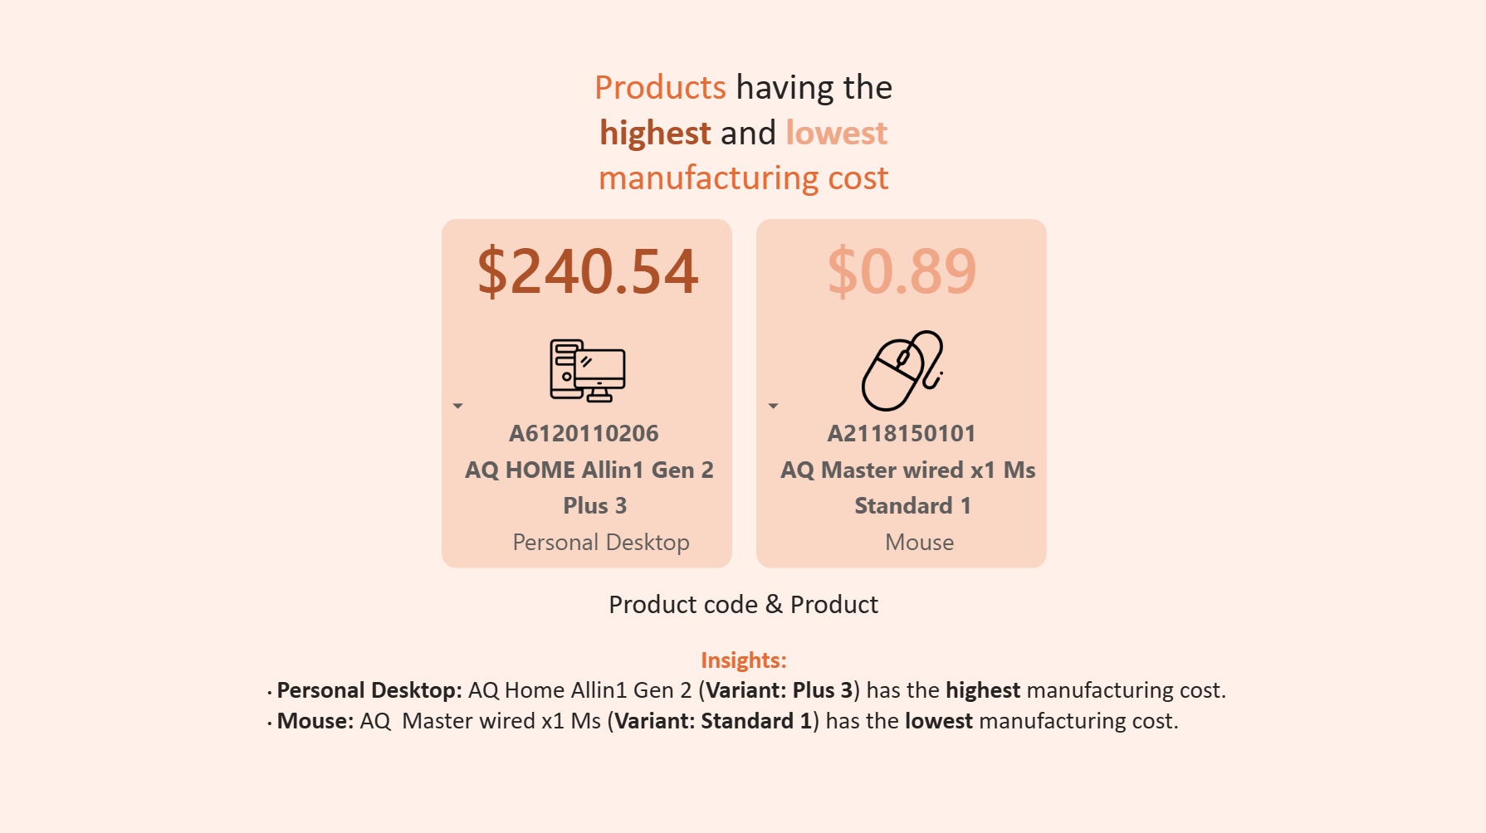

Slide 17
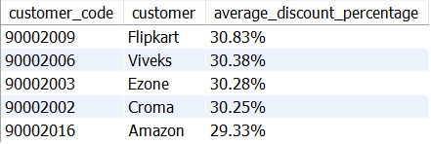
Request 6: Generate a report which contains the top 5 customers who received an average high pre invoice discount pct for the fiscal year 2021 and in the Indian market.
SELECT
c.customer_code AS customer_code,
c.customer AS customer,
CONCAT(ROUND(AVG(d.pre_invoice_discount_pct*100), 2), "%")
AS average_discount_percentage
FROM dim_customer c
JOIN fact_pre_invoice_deductions d
ON c.customer_code = d.customer_code
WHERE c.market = "India"
AND d.fiscal_year = 2021
GROUP BY c.customer, c.customer_code
ORDER BY AVG(d.pre_invoice_discount_pct) DESC
LIMIT 5;
Result

Slide 18
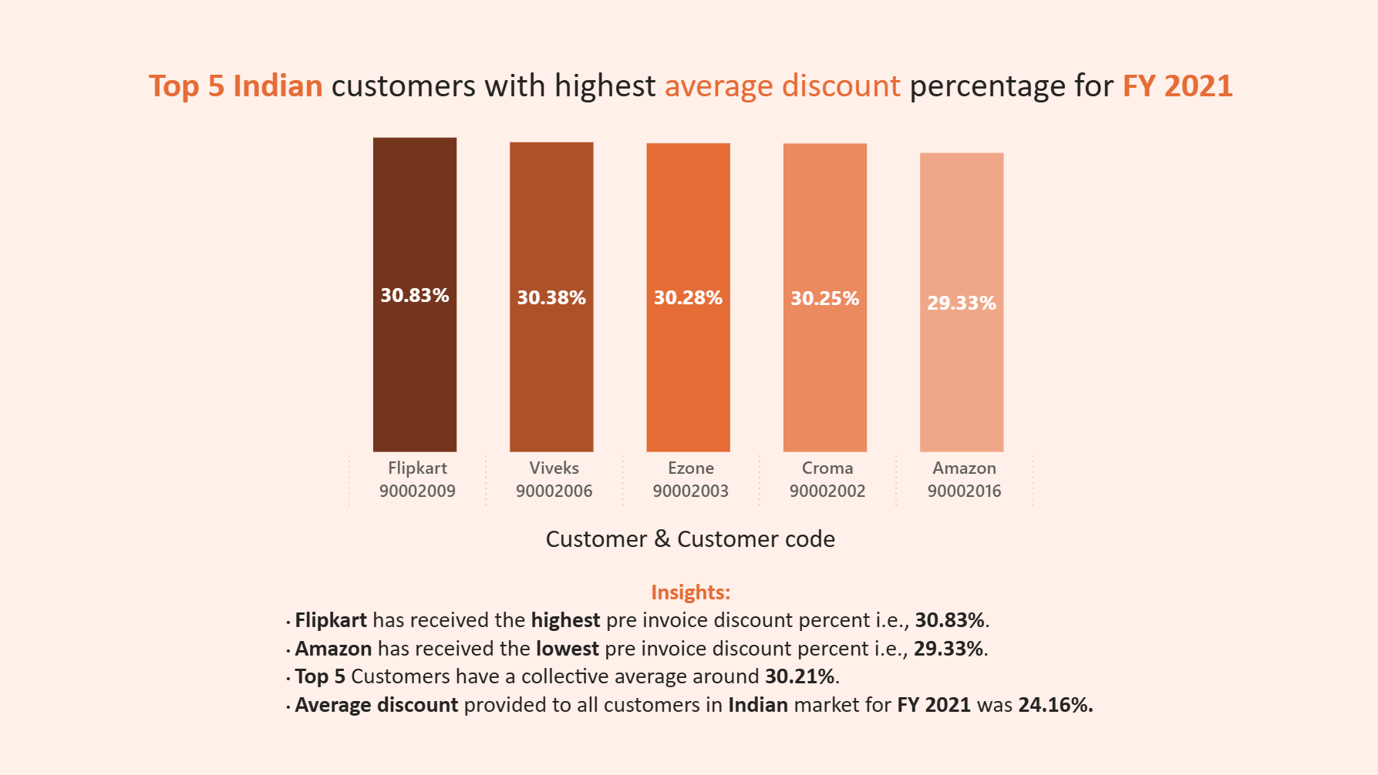

Slide 19
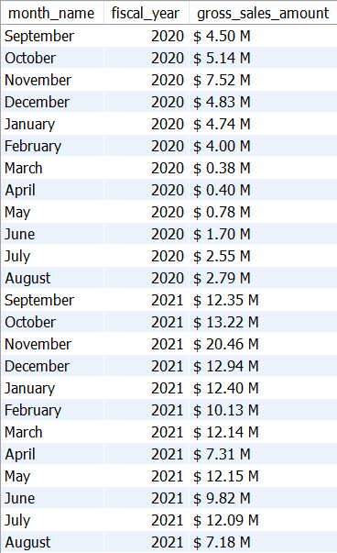
Request 7: Get the complete report of the Gross sales amount for the customer “Atliq Exclusive” for each month .
SELECT
MONTHNAME(s.date) AS month_name,
s.fiscal_year AS fiscal_year,
CONCAT("$ ", ROUND(SUM(s.sold_quantity*g.gross_price)/1000000, 2), " M") AS gross_sales_amount
FROM dim_customer c
JOIN fact_sales_monthly s
ON c.customer_code = s.customer_code
JOIN fact_gross_price g
ON s.product_code = g.product_code
AND s.fiscal_year = g.fiscal_year
WHERE c.customer = "Atliq Exclusive"
GROUP BY month_name, fiscal_year
ORDER BY fiscal_year;

Slide 20
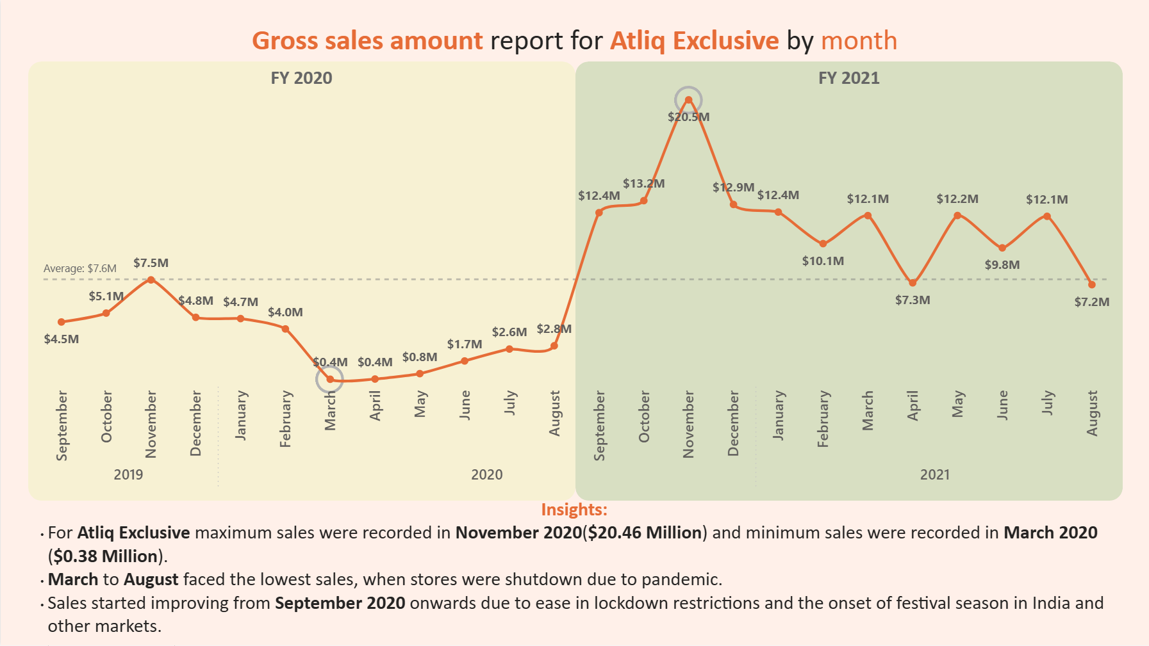

Slide 21
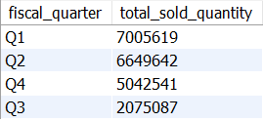
Request 8: In which quarter of 2020, got the maximum total sold quantity?
Query type 1:
SELECT
CONCAT("Q", QUARTER(DATE_ADD(date, INTERVAL 4 MONTH))) AS fiscal_quarter,
SUM(sold_quantity) AS total_sold_quantity
FROM fact_sales_monthly
WHERE fiscal_year = 2020
GROUP BY fiscal_quarter
ORDER BY total_sold_quantity DESC;
Query type 2:
SELECT
CASE
WHEN MONTH(date) IN (9,10,11) THEN "Q1"
WHEN MONTH(date) IN (12,1,2) THEN "Q2"
WHEN MONTH(date) IN (3,4,5) THEN "Q3"
ELSE "Q4"
END AS fiscal_quarter,
SUM(sold_quantity) AS total_sold_quantity
FROM fact_sales_monthly
WHERE fiscal_year = 2020
GROUP BY fiscal_quarter
ORDER BY total_sold_quantity DESC;
Result

Slide 22
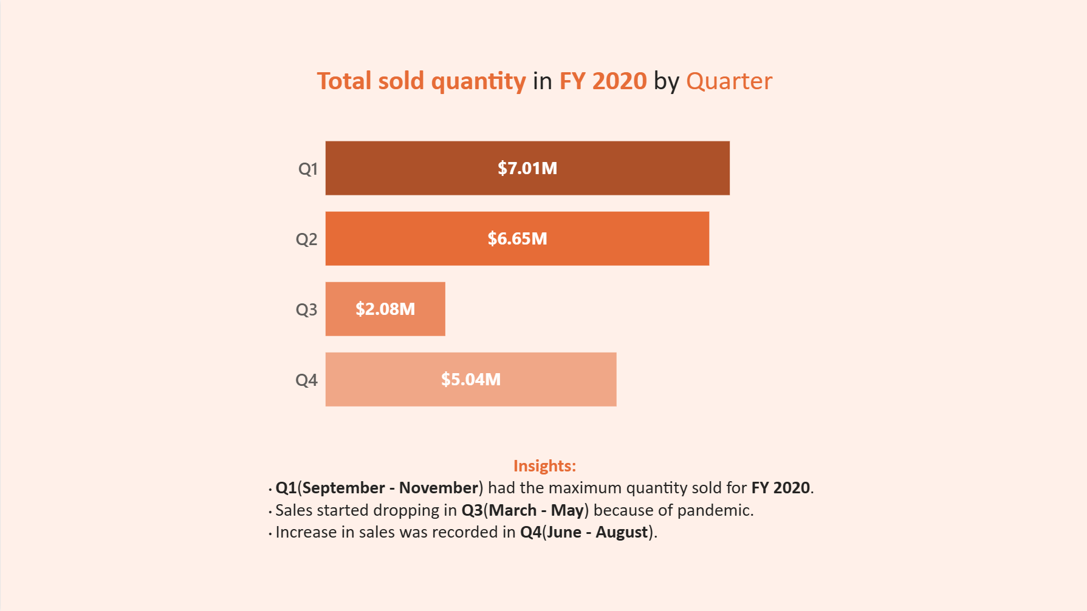

Slide 23
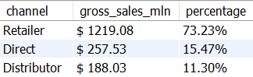
Request 9: Which channel helped to bring more gross sales in the fiscal year 2021 and the percentage of contribution?
WITH
sales_per_channel AS
(SELECT
c.channel AS channel,
ROUND(SUM(s.sold_quantity*g.gross_price)/1000000, 2) AS gross_sales
FROM dim_customer c
JOIN fact_sales_monthly s
ON c.customer_code = s.customer_code
JOIN fact_gross_price g
ON s.product_code = g.product_code
AND s.fiscal_year = g.fiscal_year
WHERE s.fiscal_year = 2021
GROUP BY channel)
SELECT
channel,
CONCAT("$ ", gross_sales) AS gross_sales_mln,
CONCAT(ROUND(gross_sales/SUM(gross_sales) OVER()*100, 2), "%") AS percentage
FROM sales_per_channel
ORDER BY percentage DESC;
Result

Slide 24
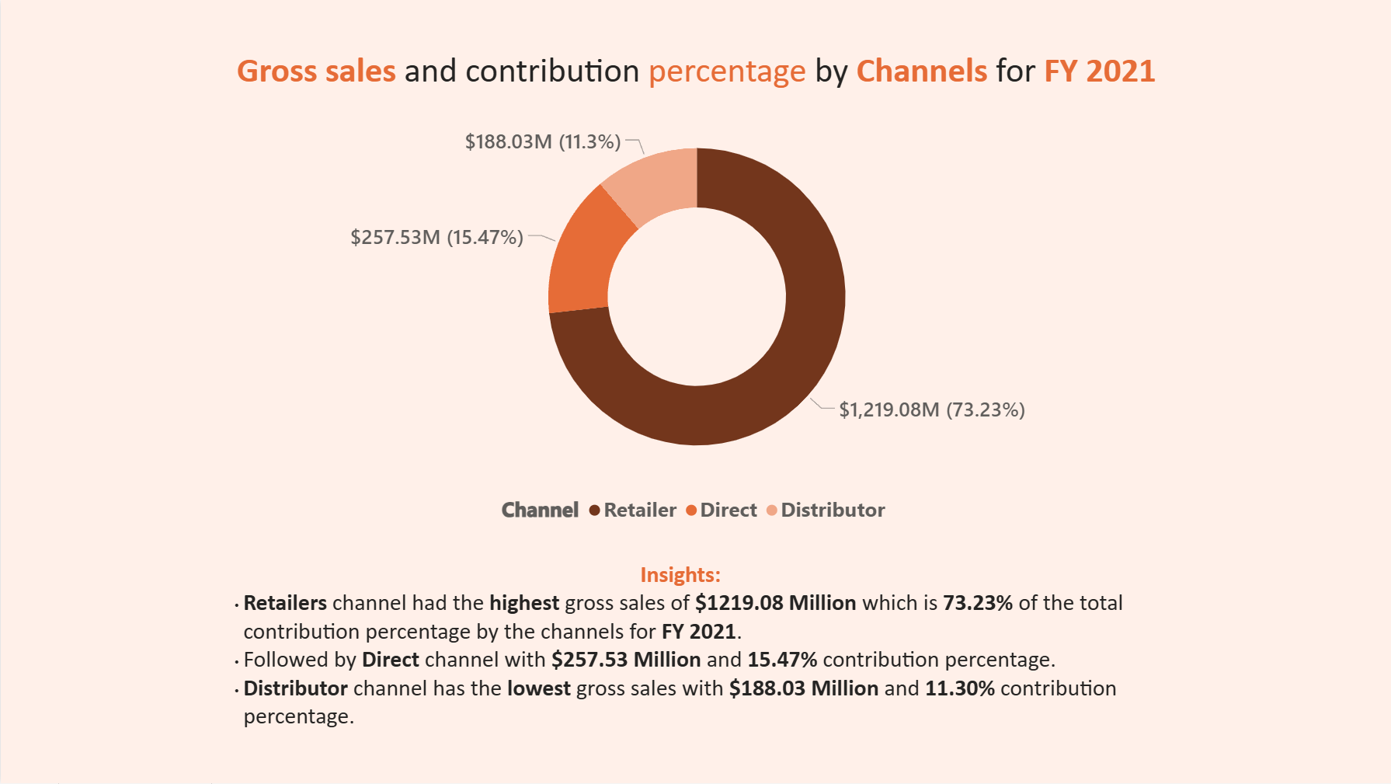

Slide 25
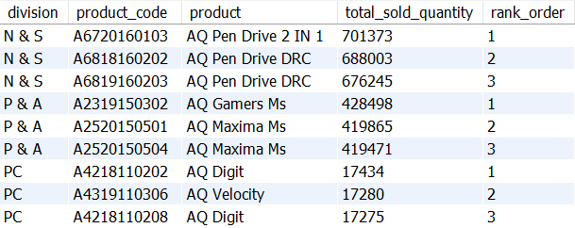
Request 10: Get the Top 3 products in each division that have a high total sold quantity in the fiscal year 2021?
WITH
products_sold AS
(SELECT
p.division AS division,
p.product_code AS product_code,
p.product AS product,
sum(sold_quantity) AS total_sold_quantity
FROM dim_product p
JOIN fact_sales_monthly s
ON p.product_code = s.product_code
WHERE s.fiscal_year = 2021
GROUP BY division, product_code, product
ORDER BY total_sold_quantity),
products_sold_per_division AS
(SELECT
*,
DENSE_RANK() OVER(PARTITION BY division ORDER BY total_sold_quantity DESC)
AS rank_order
FROM products_sold)
SELECT
*
FROM products_sold_per_division
WHERE rank_order <= 3;
Result

Slide 26
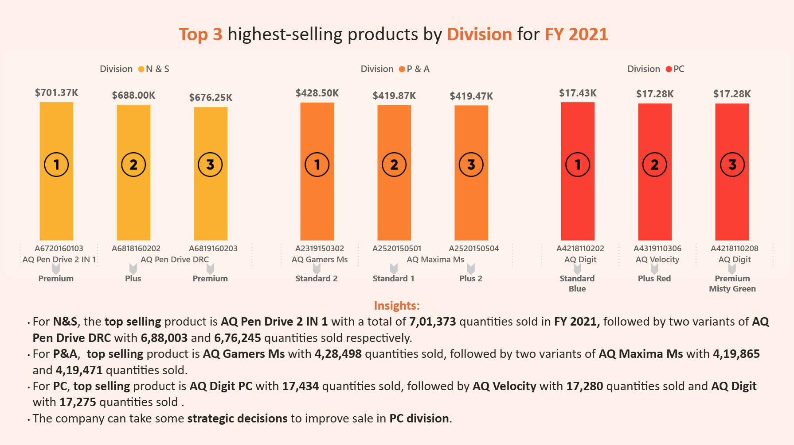

Slide 27
THANK
YOU
For your attention

